Slide 1

Rockin’ your Virtual Tech Interview
Sara Venturina
Notes:
Intro about myself

Slide 2
About the Speaker
20+ years in analytics, 50% as an end-user
23% in public sector, 23% telco, 23% in banking, 23% insurance, 8% retail
Professorial Lecturer, UP School of Statistics (part-time)

Slide 3


You already know a lot.
Don’t be shy to say you are new to this
FTW trademark of gritty women
Advantage of career switchers
Notes:
Don’t be shy to say you are new to this but the program has tested you and you have graduated, so
Comprehensiveness of the FTW curriculum,
FTW trademark of gritty women
Advantage of career shifters

Slide 4

Who is interviewing you? What does the company do?
Notes:
Usual process – HR-> tech exam → analytics manager

Slide 5
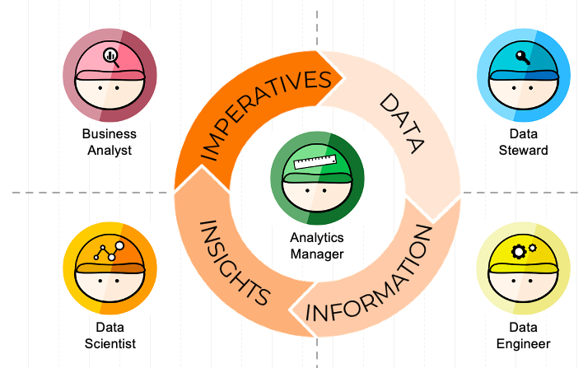

Know the job you are applying for
The Analytics Job Families

Slide 6
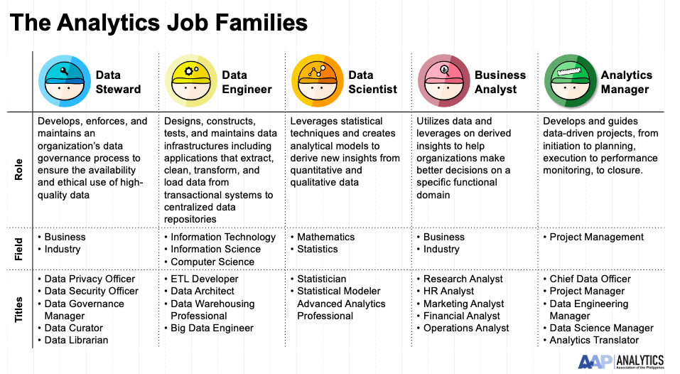
Know the job you are applying for

Slide 7
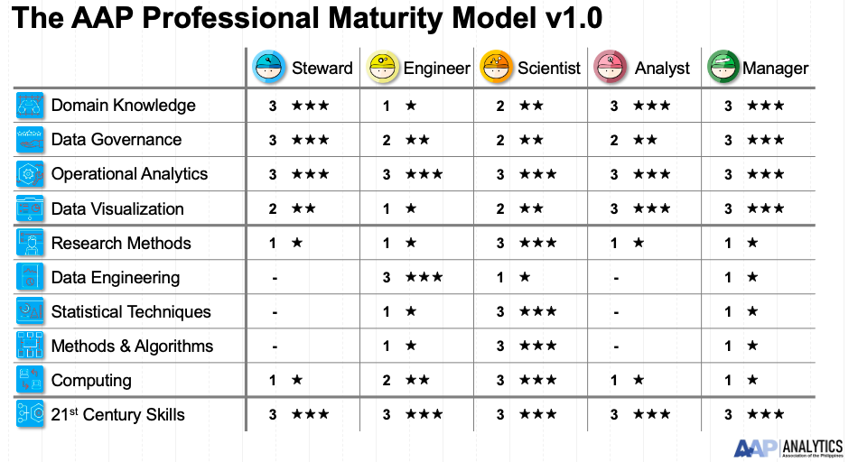
Different roles, different questions

Slide 8
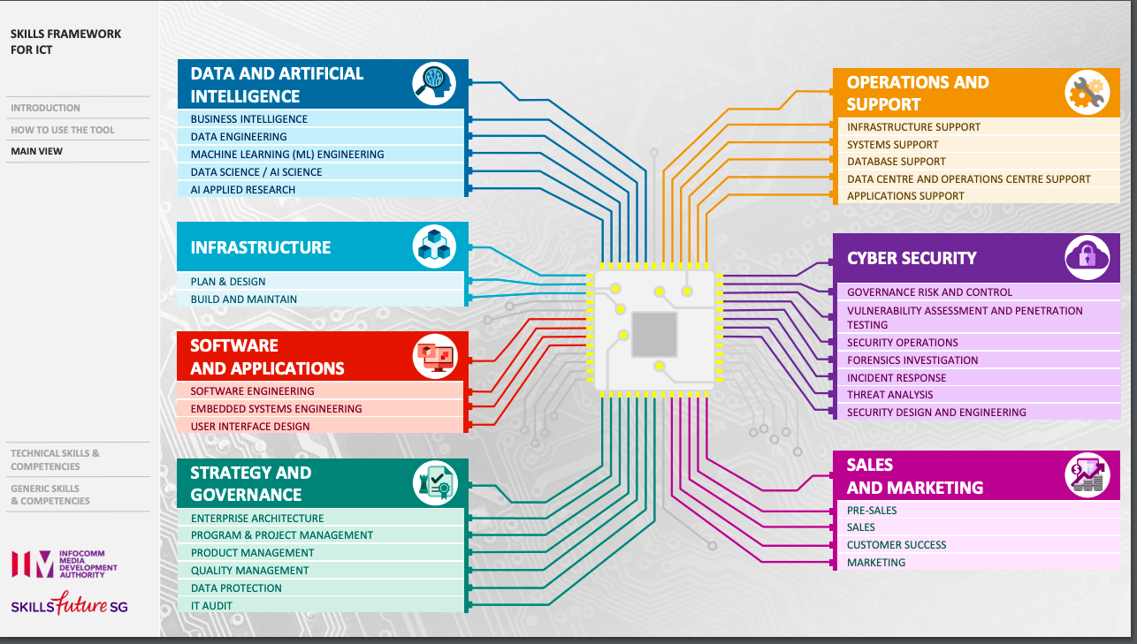
Know the job you are applying for
https://www.imda.gov.sg/-/media/IMTalent-Portal-Revamp/3-Guidances/Skills-Planning/SF-ICT/ICT-Navigation-Tool-2020.pdf?la=en

Slide 9
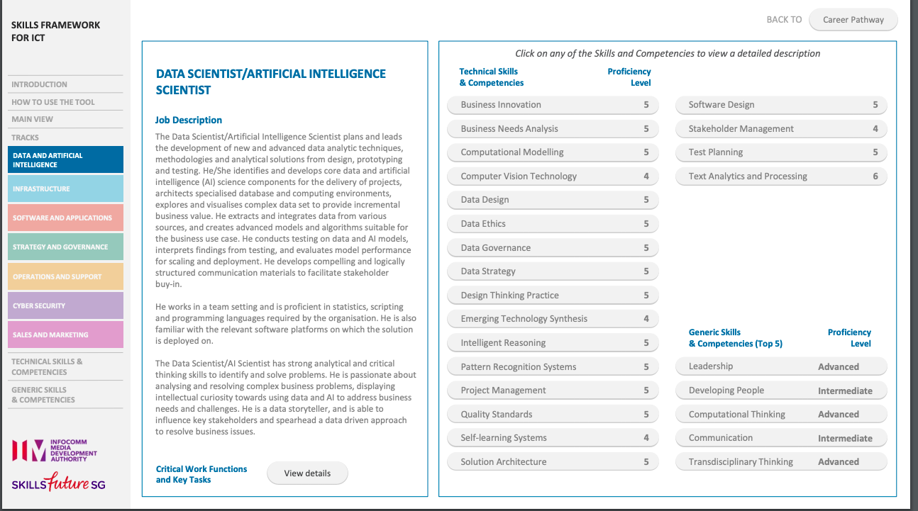
Know the job you are applying for

Slide 10
Prepare for your virtual interview

Slide 11
Prepare your device and your surroundings. if you’d like to do an extra mile, prepare a simple deck showing your skills relevant to the role. Have an emergency phone on hand in case your video call disconnects and completely fails. Remember to give the HR Recruiter your reachable number. Wear a professional attire and make sure you look presentable. Dress up as if you’re meeting your interviewer in person.

Slide 12

Talk beyond the technical concepts

Slide 13
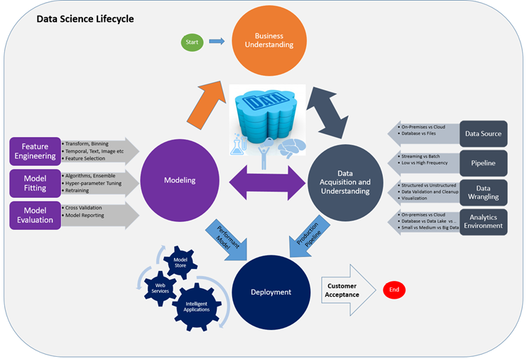
Talk beyond the algorithms
https://blog.revolutionanalytics.com/2016/10/the-team-data-science-process.html

Slide 14
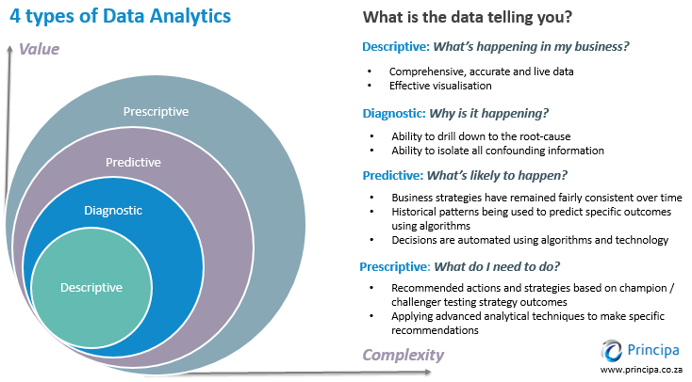
Know when to use

Slide 15
Know when to use

Slide 16

Exhibit the right mindset

Slide 17

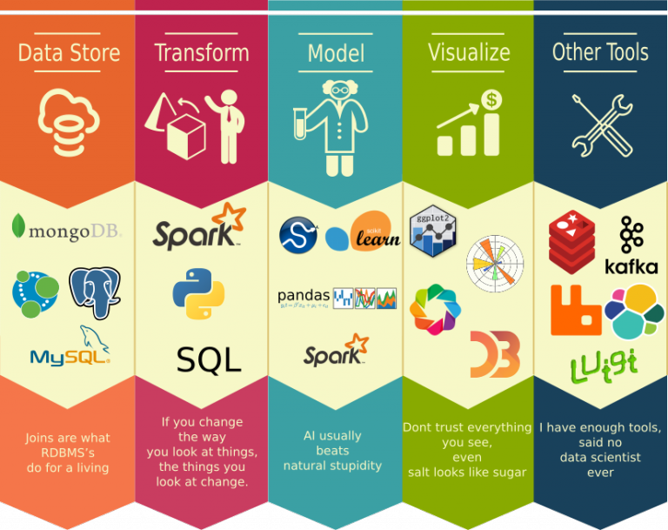
Show that you are keen in learning

Slide 18
There are always new things to learn

Slide 19

Ask questions!

Slide 20

Be sure it’s what you want

Slide 21


Slide 22

Remember!
Before:
You already know A LOT. Be confident.
Who is interviewing you? Research about the company as well.
Know the job you are applying for. So you can focus on more important skillsets for the role.
If preferred or if you’d like to do an extra mile, prepare a simple deck showing your skills relevant to the role. Discuss how you can contribute based on the job role.
Make a test call with the videoconferencing tool that will be used for your interview

Slide 23
Remember!
On Interview Day:
Make sure to be available at least an hour before your interview schedule.
Prepare your device and your surroundings. Reserve your bandwidth for the main device you’ll be using for the video call.
Have an emergency phone on hand in case your video call disconnects and completely fails. Remember to give the HR Recruiter your reachable number.
Wear a professional attire and make sure you look presentable.

Slide 24
Remember!
During:
Greet with a smile and with consideration of your interviewer’s timezone.
Relax. Speak calmly and balance your voice - not too loud, not too soft. Listen intently when your interviewer is speaking. Refrain from interrupting.
Answer briefly but with clarity. Time is essential. Be straight to the point, but professional and polite.
Make virtual eye contact by looking at your camera from time to time.
Talk beyond the technical concepts! Talk beyond the algorithms
Exhibit the right mindset
Respect the interview process. If needed, keep your questions at the end of the interview, or when asked.
After:
Be sure it’s what you want

Slide 25

ROCK ON!

